Slide 1






Introduction To Python
Author : Aman Singh
Lecture 1

Slide 2



Hello!
I am Deepak Yadu
I am here because I love to give presentations. And I want to share my knowledge with you.
You can find me at
deepakyadu404@gmail.com
2

Slide 3
Today’s Agenda
⬡ Course Introduction
⬡ Introduction to Python programming language
⬡ Setting up your environment
⬡ Getting started with Jupyter Notebook
⬡ Variables, the first program in python
⬡ Numbers and basic calculations
⬡ Python Objects
⬡ Booleans and expressions
⬡ Sequences
3

Slide 4
Agenda Cont.
⬡ If else / elif statements
⬡ Types of loops
⬡ For loops
⬡ List comprehensions
⬡ Slicing of lists
⬡ Functions in python
⬡ Lambda function
⬡ Generator functions
⬡ File Handling
4

Slide 5



What is Python Programming Language?
Let’s start…

Slide 6
What is Python Programming Language?
⬡ Python is an interpreted language, that means no compiling
and no linking required.
⬡ Interpreter: an interpreter is a computer program that directly executes
instructions written in a programming or scripting language, without requiring
them previously to have been compiled into a machine language program.
⬡ High level language
⬡ Modes : Interactive / Standard
⬡ Python 2 (legacy) / python 3 (present and future)
⬡ Beginner friendly

Slide 7
History of python
⬡ Python was developed by Guido Van Rossum 1991
⬡ Launched python 2 in 2001 & python 3 in 2008
⬡ Python 3 not backward compatible
⬡ Python 2.7's end-of-life date was initially set at 2015
then postponed to 2020

Slide 8
Uses of python
⬡ Web App development
⬡ Machine learning
⬡ Artificial Intelligence
⬡ Data Science
⬡ Hacking (Favorite language b/w hackers)

Slide 9
Advantages of python
⬡ Large Community
⬡ Multipurpose and cross platform
⬡ Interpreted (best for prototyping)
⬡ User friendly
⬡ Large amount of libraries

Slide 10
What is Anaconda Distribution?
Let’s start…

Slide 11

What is Anaconda Distribution?
⬡ Anaconda is an open source distribution for python and R
⬡ Used for Data Science, Machine learning and deep learning
⬡ Simplified package management and deployment
⬡ More than 300 Data Science packages comes preinstalled.

Slide 12
Installation
⬡ Go to www.anaconda.com
⬡ Download suitable version
⬡ Open setup and follow instructions
⬡ Run the application after installation

Slide 13
Basic anaconda commands
⬡ Open anaconda-prompt
⬡ Commands:
# Conda --help
# Conda list //list all packages
# # # # # # #
conda install <package name> //install a package
Conda create my_app //create virtual environment named my_app
Activate my_app //activate virtual environment
Deactivate //deactivate your virtual environment
Conda env list // list virtual environments
Conda remove my_app --all //remove virtual environment including all pakages
Jupyter notebook //start Jupyter notebook

Slide 14
What is Jupyter Notebook
Let’s start…

Slide 15
Jupyter Notebook…
⬡ A client-server application allows us to edit and run our notebook
via a browser. (.ipynb)
⬡ Its two main components are the kernel and dashboard.
⬡ Create share document and contains live code, equations,
visualization as well as text.
⬡ Best suited for exploratory data analysis
15

Slide 16
What is Jupyter Notebook
Let’s start…

Slide 17
Jupyter Notebook…
⬡ A client-server application allows us to edit and run our notebook
via a browser. (.ipynb)
⬡ Its two main components are the kernel and dashboard.
⬡ Create share document and contains live code, equations,
visualization as well as text.
⬡ Best suited for exploratory data analysis
17

Slide 18
Let’s start the Python

Slide 19
Numbers in python
⬡ Python provides three different types of numbers
Integers
Floating Points
Complex
⬡ Integers have unlimited precision, integer would never be too long in
python.
⬡ Supports all usual Arithmetic Operation: ADD, SUB, MUL, DIV, POWER.
⬡ By default division returns floating point, we can specify integer division by
using double slashes.
⬡ Underscore operator value is always the last object that python returns in
interactive mode.
⬡ You can use math library for more scientific calculations e.g. math.factorial,
math.PI
18

Slide 20
Variables
⬡ Variables are containers for storing values.
⬡ Python don’t have command to declare a variable. A variable is
created the moment you first assign it.
⬡ No need to specify data type. It implicitly identifies the data type.
⬡ Rules to write a variable: -
a variable name must start with a letter or the underscore character.
A variable name cannot start with a number.
Only contain alpha-numeric and underscore characters.
variable names in python are case sensitive.
19

Slide 21
What is an Object?
Let’s start…

Slide 22
Objects…
⬡ Python contains many data types as part of core language. Its import to understand that all data in python program is represented by objects and relationship b/w objects.
⬡ Everything in a real world scenario is an object.
⬡ Object is simply a collection of attributes and methods or variables
and Functions in other words.

Slide 23

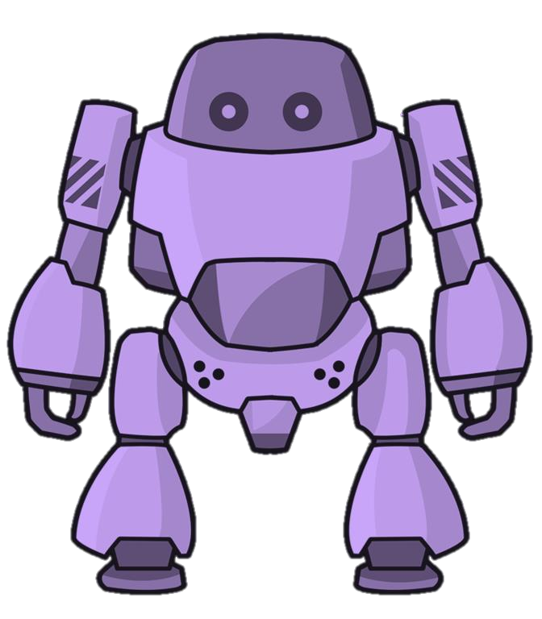
Hello There!
I am chitti the robot.
Name: Chitti Colour: Purple Job: Dance

Slide 24
Objects…
⬡ Values of Objects can be changed during the program execution.
⬡ The objects whose values can change are called Mutable objects
whereas objects whose values are unchangeable are called
Immutable objects.
⬡ In python every object has three characteristics:
Type: object type tells what kind of object we are dealing with. like
(string, list, tuples, etc.)
Value: Data that is contained by the object.
Id: its is a number to identify different objects.
⬡ Two immutable objects can have same ids in python. Whereas
for mutable objects id is always different.
⬡ Two distinct object has same methods but not same attributes.

Slide 25
Data Types
Let’s start…

Slide 26
Data types…
⬡ Data types are classification of data items.
⬡ It represents the kind of value and tells us what operations can be
performed on a particular data.
⬡ Everything in python is an object so, data types are actually
classes and variables are instance (object) of these classes.
⬡ Data types in Python:
Numbers (integer, Float, Complex)
Sequences (string, list, Tuples, range)
Boolean
Sets (set, frozen set)
5. Dictionary
25

Slide 27
What is Sequence?
Let’s start…

Slide 28
Sequences…
⬡ A sequence is a collection of object ordered by their position.
⬡ In python there are three basic sequences :
Lists
Tuples
Range Objects
⬡ Strings are special type of sequence that can only store characters
and they have special notations.
⬡ However, all the sequence operation described here can be used
on strings.
⬡ Sequence index starts at 0.
28

Slide 29
Slicing…
⬡ Objects can be accessed from left to right with positive index and right to left using negative index.
⬡ We can access multiple objects using by colon operator:
# seq[3:6]
# seq[:]
#seq[4:]
#seq[:-5]
29

Slide 30
String
Let’s start…

Slide 31
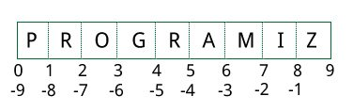
Strings…
⬡ A string is a sequence of characters.
⬡ String are immutable objects.
⬡ You can enclose strings under single quotes / double quotes and
triple single quotes.
⬡ You can perform slicing on strings like any sequence.
⬡ You can concatenate strings using ‘+’ operator.
⬡ You can also perform string multiplication.
⬡ You can only concatenate string to another string.
⬡ Use str() function to explicitly convert that number to string.
31

Slide 32
String Methods
⬡ Check available string methods using dir()
⬡ To get information about any method use help()
⬡ Strip()
⬡ Split()
⬡ Replace()
⬡ Lower()
⬡ Upper()
32

Slide 33
lists
Let’s start…

Slide 34
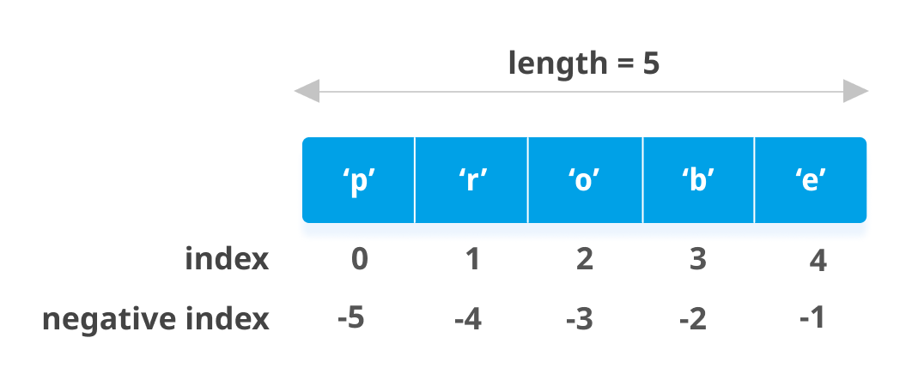
Lists…
⬡ List are mutable sequence of objects of any type.
⬡ Typically used to store homogeneous items.
⬡ Comparing to strings lists are mutable objects of any type
whereas strings are immutable objects of only character type.
⬡ We can change values of lists after creating them.
⬡ We can perform all slicing operations like other sequence.
⬡ we can concatenate two lists using + operator.

Slide 35
List Methods
⬡ Reverse() # it will arrange elements of list in reverse order.
⬡ List methods are called in-place methods, they modify the original
list.
⬡ Sort() #sort elements alphabetically
⬡ Sorted()# returns a new sorted object
⬡ Len()
⬡ pop() #take out last element and return.
⬡ Insert(position, object) #insert object to specific location.
⬡ List.remove(object) remove a specific object.

Slide 36
Tuples…
⬡ Tuples are same as lists but immutable.
⬡ Tuples are immutable sequence of objects of any type.
⬡ You can create tuples by using constructor method or by using
parentheses.
⬡ We can perform all operations of sequences.
⬡ You can add two tuples.
⬡ If there is only one object in tuple it is not considered as a tuple
instead its type will be class it is made from.
⬡ To create a tuple of one element use (1,) method.
⬡ You can always check for membership in of a particular item in the
list.

Slide 37
Sets…
⬡ Sets are unordered collection of distinct hashable objects.
⬡ In python all types of immutable objects are hashable objects.
⬡ There are two types of sets in python one is just ‘Set’ and another
is ‘Frozenset’.
⬡ Frozen sets are immutable, in contrast normal sets are mutable.
⬡ You can create sets using set constructor or by adding values
withing curly brackets.

Slide 38
Dictionaries…
⬡ A dictionary is a collection which is unordered mutable and
indexed.
⬡ Dictionaries are mapping from key objects to values.
⬡ Every item in the dictionary is in the form key and value pair where
the keys must be immutable and the vales can be anything.
⬡ Dictionaries are mutable objects that means you can modify its
content after creating it.
⬡ Fast Lookup for unordered data.

Slide 39
























Name
Jack
Age
24
Gender
Male
person = {'Name' : 'Jack', 'Age' : 24, 'Gender’ : 'Male'}

Slide 40
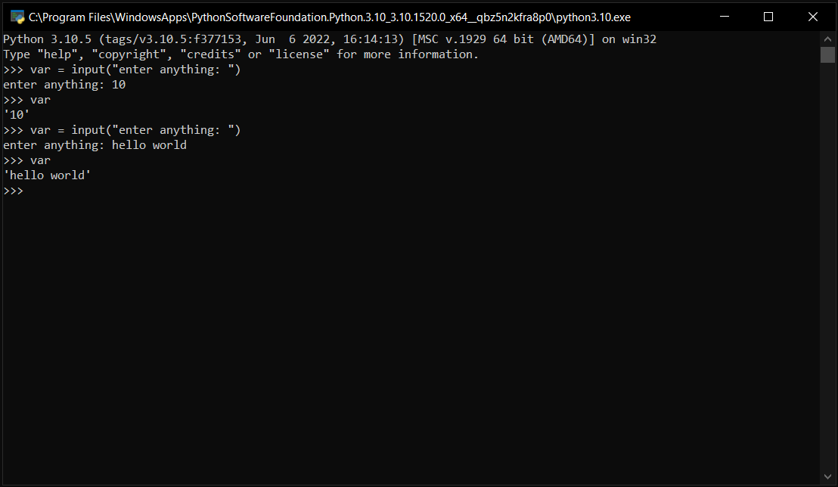
Dynamic Typing…
Python is a dynamically typed language. This means that the Python interpreter does type checking only as code runs, and the type of a variable is allowed to change over its lifetime

Slide 41
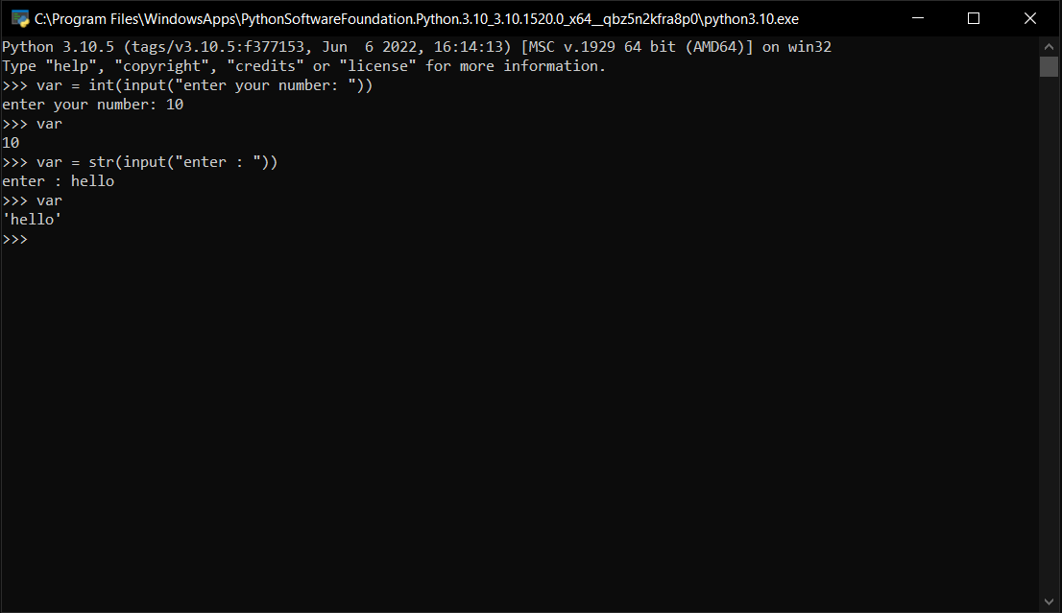
Static Typing…
The opposite of dynamic typing is static typing. Static type checks are performed without running the program. In most statically typed languages, for instance C and Java, this is done as your program is compiled. The type of a variable is not allowed to change over its lifetime.

Slide 42
Booleans & Expressions
Let’s start…

Slide 43
Booleans & Expressions
⬡ Expression is a combination of objects and operators that
computes a values.
⬡ Objects of the Boolean type have only two values: True / False
⬡ Remember to capitalize the values.
43

Slide 44
Logical Operators
⬡ Logical operation takes in one or more Boolean objects and then
returns Boolean objects back to you.
⬡ There are only three logical operators in python: and / or / not
⬡ AND only returns true if both objects are true.
⬡ OR returns true if either of its given condition is true.
⬡ NOT operator negates the value of object.
44

Slide 45
Comparison Operators
⬡ Comparison operators are typically used for comparing numbers but we can use it to compare other objects also.
⬡ == is equality operator
⬡ != is opposite of equality operator
⬡ ‘is’ and ‘is not’ are identity operator
⬡ ‘in’ and ‘not in’ are membership operators
45

Slide 46
Decision Making
Syntax:
if(expression): statements
⬡ Decision making is required when we want to execute code only if a certain condition is satisfied.
⬡ In python if…else statement is used
for decision making.

Slide 47


Using only if :
If a > 10
False
True
Print(“a is greater than 10”)
STOP

Slide 48


Using if and else :
True
If a > 10
False
Print(“a is greater than 10”)
Print(“a is smaller than 10”)
STOP

Slide 49




Using nested if :
True
If a > 10
False
Print(“a is greater than 10”)
True
If a > 5
False
Print(“a is greater than 5”)
Print(“a is smaller than 5”)
STOP

Slide 50
Loops…
⬡ Loops are used to run a block of code continuously until a certain
condition is reached.
⬡ Reusability of code.
⬡ In python we have For loop and While loop.

Slide 51
For loops:
⬡ For loop in python is used to iterate over a sequence (list, tuples, strings) or other iterable objects.
⬡ Iterating over sequence is called traversal.
⬡ Loop continues until we reach the last item in the sequence or the loop is early terminated using break statement.

Slide 52





Last item is reached?
Body of Code

Slide 53
Range objects
⬡ We can generate sequence of numbers using range function.
⬡ It takes three parameters (start, stop, step)
⬡ Range object does not store all numbers in memory.
⬡ We need to force this function to output all the
items.

Slide 54
While Loop:
Syntax:
⬡ While loop in python is used to iterate over a block of code as longs as the test expression (condition) is True.
⬡ While loops is generally used when we don’t know
how many times we want to run the block of code.
While( expression):
statements

Slide 55


Test expression
Body of Code

Slide 56
Break and Continue
⬡ It is used to early terminate the loop without checking test expression.
⬡ Continue statement is used to skip rest of the code inside loop for the current iteration only, it does not terminate the loop.

Slide 58

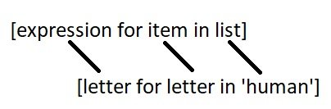
List Comprehensions…
⬡ List comprehension is an elegant way to define and create lists based on existing lists.
⬡ List comprehension is generally more compact and faster than the normal function and loops for creating loops.
⬡ We can also use conditions within list comprehensions.
⬡ We can also provide if...else condition within list comprehension.

Slide 59
Functions
⬡ A function is group of instructions or statements which only runs
when it is called.
⬡ By using function we can avoid rewriting same logic/code again
and again.
⬡ We can call function as many times we want.
⬡ It becomes easy to organize a large code with using functions.
⬡ There are basically two types of functions:
Built-in functions
User-defined function.

Slide 60
Built-in Functions
⬡ These function are already built-in the python interpreter. For
example, print(), range(), list() etc.
User defined Functions
⬡ Functions that we need to define are called user defined functions.
Syntax:
def function_name (parameters): statements

Slide 61
Syntax:
def function_name (parameters):
statements
⬡ Keyword “def” marks the start of function header.
⬡ Function name is a unique name given to identify a function.
⬡ Parameters (optional): used to pass values to the function.
⬡ Colon is used to marl the end of the function header.
⬡ A function body is made up of one and more statements.
⬡ Return (optional): a function can have return statement to return objects.

Slide 62
Arguments
⬡ Positional Arguments
⬡ Keyword Arguments
⬡ Arbitrary Arguments

Slide 63
Variable Scope
⬡ The variable is only available from inside the region it is created, this region is
called scope.
⬡ Local Scope: the variable is not available outside the function, function but it is
available for any function inside.
⬡ Global Scope: a variable create in the main body of the program is a global
variable and belongs to the global scope.
⬡ If you operate with the same variable name inside and outside of the function,
python will treat them as two separate variable, one available in the global
scope (outside the function) and one available in the local scope (inside the function).
⬡ Global keyword is used to create global variables within a function or using a
global variable i.e. defined outside the function.

Slide 64
Anonymous Functions
⬡ In python an anonymous function is a function that is defined
without a name.
⬡ Anonymous functions are defined using “lambda” keyword, Hence
it is also knows as lambda function.
Syntax:
lambda arguments: expressions
⬡ Lambda functions have any number of arguments but only one
expression, the expression is evaluated and returned.
⬡ You can use lambda function to create small single line function.

Slide 65
Filter and Map
⬡ Anonymous function is also used along with built-in function like filter() and
Map().
⬡ Filter Function: the function is called with all the items in the list and a new list is
returned which contains items for which the function evaluate to true.
⬡ Example : list(filter(lambda x : (x%2 == 0), mylist))
⬡ Map: this function is called with all the items in the list and a new list is returned
which contains items returned by that function for each item.
⬡ Example : list(map(lambda x : x**2, mylist))

Slide 66
Python generators
⬡ Python generators are a simple way of creating iterators.
⬡ Generator function is that function that iterator object which we
can iterate over one value at a time.
⬡ It is very useful for creating such program where memory
optimization is very important.
⬡ Creating a large list will occupy a very large space in memory, but
a generator will occupy that much memory which is required to
store one value.
⬡ Still we can generators as a normal iterable object.
⬡ A generator can be created by replacing return statement with
yield statement in a function.

Slide 67
Cont…
⬡ Difference between yield and return is that, return will terminate
the function entirely and yield statement will pause the function
saving all states and later continues from these on successive calls.
⬡ When the generator is empty it will raise stop iteration error.
⬡ You can convert generator to list by simply calling the list function
but, you will also loose the advantages of generators.
⬡ It is recommended to use for loop while with generators.

Slide 68
Cont…
⬡ You can create a simple generator using generator expression just like list
comprehensions.
⬡ The main difference between generator expression and list comprehension is
that, list comprehension creates entire list at once whereas generator
expression creates one value at a time.
⬡ Example . (x ** 2 for x in range(10) )

Slide 69
File Handling
⬡ Python programming language mate it very easy to work with
files.
⬡ A basic file operation takes place in the following order:
Open a file
Read or Write
Close the file
⬡ To open a file python has a built-in function open(). It takes two
parameters (Filename, Mode).

Slide 70
Modes
Mode | Description
‘r’ | Opens a file for reading, error if the file does not exists. (default)
‘w’ | Write opens a file, create a new file if does not exists
‘a’ | Append to file, create a file if does not exist
‘x’ | Create a new file, error if file exists
‘t’ | Handle file as text (default)
‘b’ | Handle file as binary e.g. image

Slide 71


Thanks!
Any questions?
Just Comment down below.
If you like this video don’t forget to
Subscribe and Share

